Slide 1

Measuring Output for U.S. Commercial Fisheries — From Theory to Practice
Emily Markowitz¹ and Sun Ling Wang²
¹Contractor, ECS Federal in support of
NOAA Fisheries Office of Science and Technology
Economics & Social Analysis Division
²On detail with the
NOAA Fisheries Office of Science and Technology
Economics & Social Analysis Division
Tuesday April 13, 2020
Fishery Productivity Workshop 2020:
Measurement, Data Sources, and the Pattern of Growth
Silver Spring, MD/Remote
*The views expressed are those of the author and should not be attributed to the NOAA, ECS or ERS
Notes:
Hi!
I am Em and I should start of by first stating that I am not an economist and I have not previously worked with economic productivity analyses before. My background is actually in quantitative fisheries ecology.
Since I started with NOAA Fisheries in the Knauss Fellowship I’ve been putting my quantitative skills to the test, like here. Sun Ling and I have been working together since day one of her detail in OST and it has been fun to apply productivity theory to these data I know from a biological perspective.

Slide 2


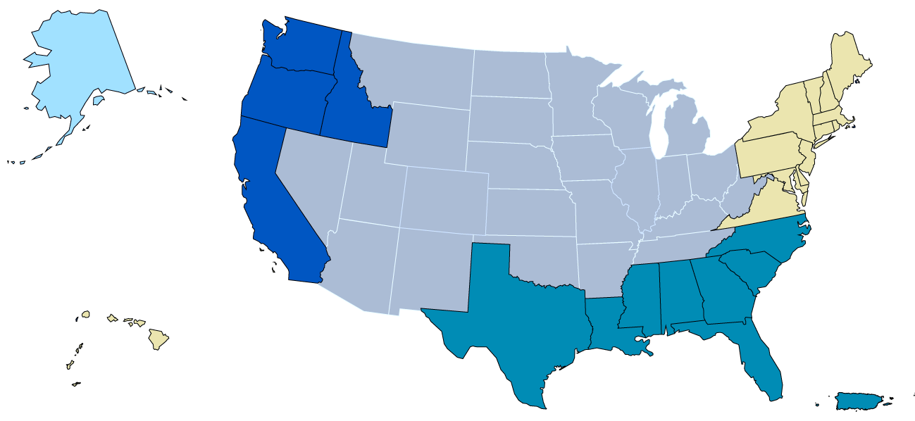
Study Purpose
Develop alternative approaches to measure national and regional fishery outputs for productivity measurements.
Evaluate the impacts of missing data and other issues on output estimates.
Pacific
New England
North
Pacific
Mid-Atlantic
West Pacific
South Atlantic
Gulf of Mexico
Notes:
Here we want to Develop alternative approaches to measure fishery outputs for productivity measurements for the US and for each of the 7 regions.
To do that appropriately, we really needed to explore the impacts of missing data and other issues on output estimates.

Slide 3




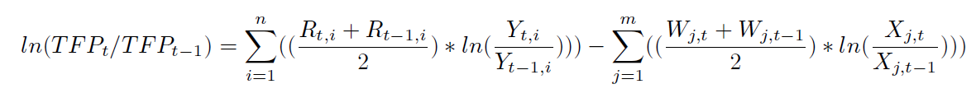
Theoretical Framework: Törnqvist index A Flexible Function and Superlative Quantity Index (Diewert 1976)
Our Focus
Output
(Landings data)
Input (KLEMS data)
2-Year Average Output Revenue Shares
Quantity change of outputs
2-Year Average Input Cost Shares
Quantity Change of Inputs
Notes:
The equation for the 2 main models can be described by this theoretical Törnqvist index framework. It is a Flexible Function and Superlative Quantity Index
[Click] The first part is the output, which is composed of 2 year average revenue shares and quantity change. Output, for our purposes, will represent National or Regional commercial fisheries landings.
[Click] The second part represents all the capital, labor, energy, materials, and services costs that went into obtaining the output and follows a similar equation setup. Finding the data for this input side of the equation has proven to be a bit more difficult than anticipated, ...
[Click] …so for this exercise we are simply going to attempt to solve the output side of the equation.

Slide 4
Calculating Output in Productivity Accounting: Methods
Simple Sum of Quantity
Quantity Model
Price Model
Output = Landings
For each species
Determine which species have enough data
For each Fishing Category
For the Entire Fishing Sector
Revenue change
Implicit quantity index
Revenue-share
Revenue-share weighted price changes
Price
Revenue index
Revenue-share
Revenue-share weighted
Implicit quantity index
Revenue index
Revenue change
For each species
Determine which species have enough data
Quantity-share weighted quantity changes by quantity
For each Fishing Category
Revenue change
For the Entire Fishing Sector
Quantity change
Quantity-share
Revenue-share weighted
Quantity index
Revenue index
Revenue-share
Notes:
First we’ll start off with the theory of approaching this and the 3 models we developed the results for

Slide 5
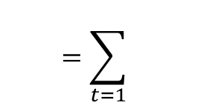
Output Measurement 1: Simple Sum
Calculate the simple sum of fisheries quantity from species’ quantities
Entire Commercial Fishing Sector
Commercial Fishing
*No data is removed the original data set
Species (s)
$$=\sum_{t=1}{}$$
Cod
Flounder
Lobster
Seaweed
…
Notes:
We’ll start with this approach first – where we simply sum quantity (or Q) data for all the species to obtain a sum quantity for the entire fishery. No data is removed for as data will be in the next two models.

Slide 6

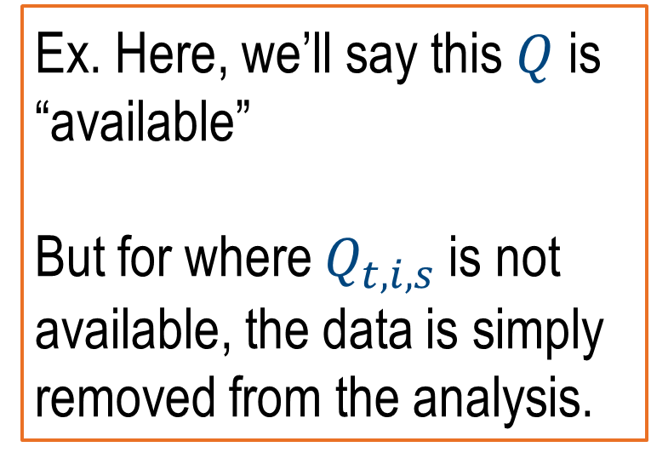
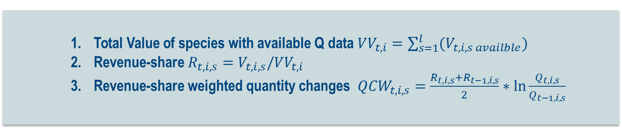
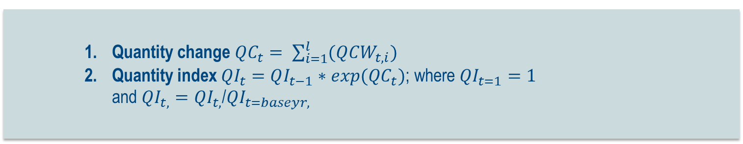
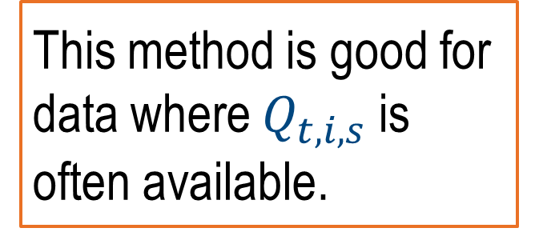
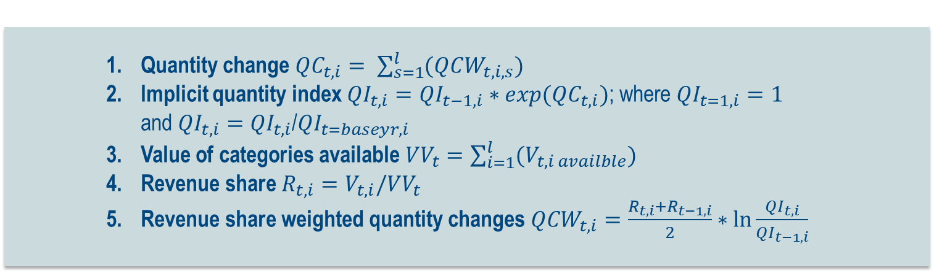
Output Measurement 2: Directly from Quantity Data
Total Value of species with available Q data ${VV}_{t,i}=\sum_{s=1}^{l}{(V_{t,i,s availble})}$
Revenue-share $R_{t,i,s}=V_{t,i,s}/{VV}_{t,i}$
Revenue-share weighted quantity changes ${QCW}_{t,i,s}=\frac{R_{t,i,s}+R_{t−1,i,s}}{2}∗\ln{\frac{Q_{t,i,s}}{Q_{t−1,i,s}}}$
For each Species (s)
 |  | Generic Fish
 |  | Q | V
 | 2007 | 2000 | NA
 | 2008 | NA | 2700
 | 2009 | 2000 | 2000
 | 2010 | 2500 | NA
 | 2011 | NA | 3100
 | 2012 | 2300 | 4600
 | 2013 | NA | 2800
 | 2014 | NA | 3200
 | 2015 | NA | 3500
 | 2016 | 2200 | 3200
Quantity change ${QC}_{t,i}= \sum_{s=1}^{l}{(QCW_{t,i,s})}$
Implicit quantity index ${QI}_{t,i}=QI_{t−1,i}∗exp(QC_{t,i})$; where ${QI}_{t=1,i}=1$ and ${QI}_{t, i}={QI}_{t, i}$/${QI}_{t=baseyr, i}$
Value of categories available ${VV}_{t}=\sum_{i=1}^{l}{(V_{t,i availble})}$
Revenue share $R_{t,i}=V_{t,i}/{VV}_{t}$
Revenue share weighted quantity changes ${QCW}_{t,i}=\frac{R_{t,i}+R_{t−1,i}}{2}∗\ln{\frac{{QI}_{t,i}}{{QI}_{t−1,i}}}$
This method is good for data where $Q_{t,i,s}$ is often available.
For each Fishery Category (i)
Ex. Here, we’ll say this $Q$ is “available”
But for where $Q_{t,i,s}$ is not available, the data is simply removed from the analysis.
Quantity change ${QC}_{t}= \sum_{i=1}^{l}{(QCW_{t,i})}$
Quantity index ${QI}_{t}=QI_{t−1}∗exp(QC_{t})$; where ${QI}_{t=1}=1$ and ${QI}_{t,}={QI}_{t,}$/${QI}_{t=baseyr,}$
For the Entire Commercial Fishing Sector
Notes:
I won’t get to deep in the math here – we can review these slides later if needed in the discussion– but the main takeaway is that this method simply uses the available quantity data at the species level to develop revenue-share weighed quantity changes.
[Click] When I say “available” I mean to say we have enough data in a time series to adequately assess this species for the rest of the calculation. However, if Q for a species is not available, it is simply removed from the analysis.
[Click] Then we calculate the revenue share, QI, and revenue-share weighted quantity changes at the category level.
[Click] which are used at the commercial fishery level to develop the annual quantity change and index.
[Click] These, specifically the QC, are what go into the output equation.
This method is good for data where $Q_{t,i,s}$ is often available.

Slide 7

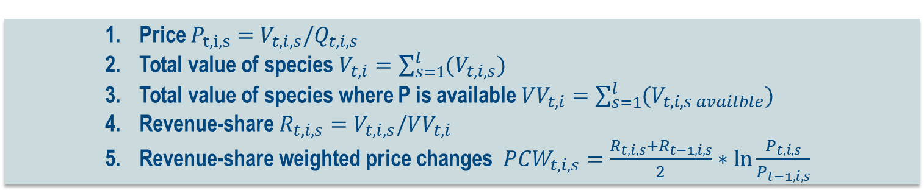
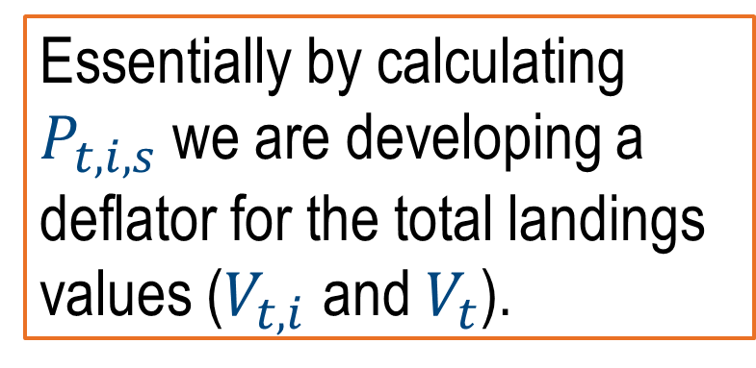
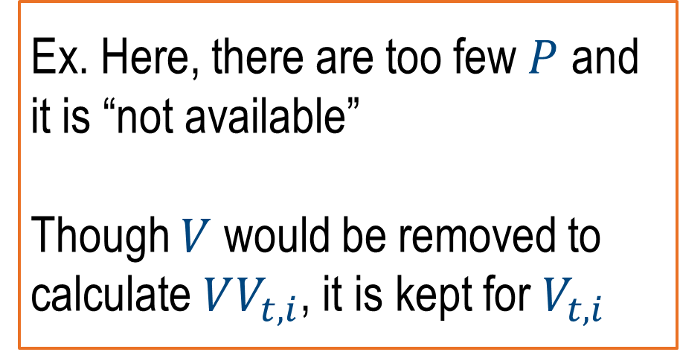
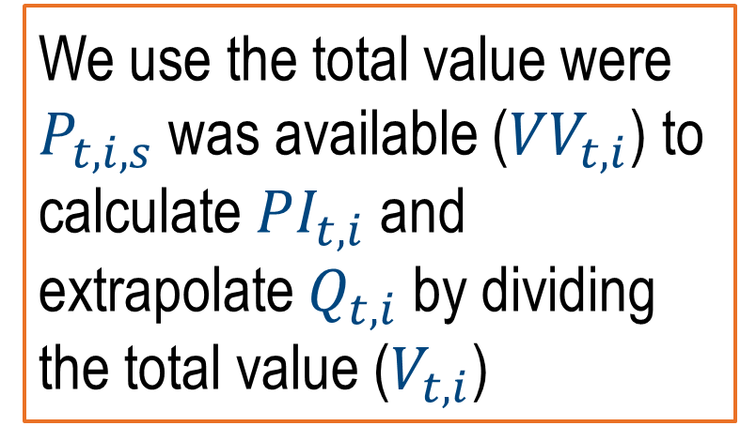
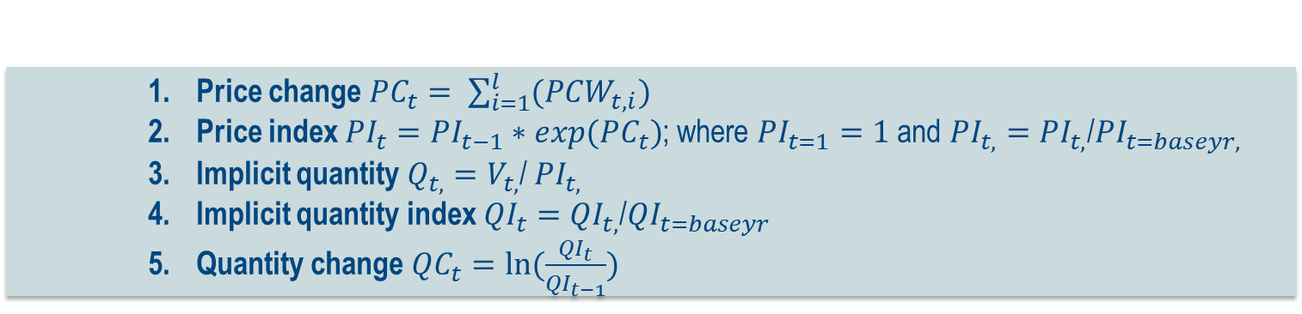
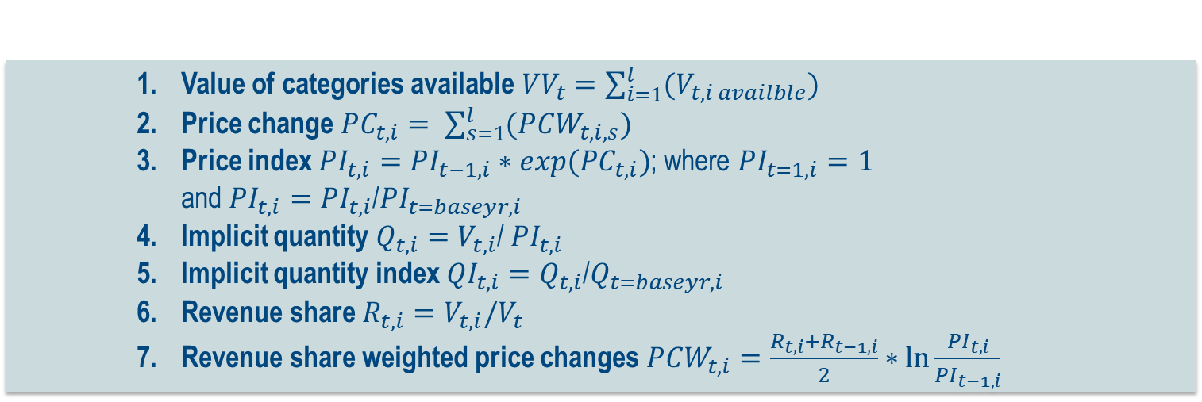
Output Measurement 3: Price to Implicit Quantity
Price $P_{t,i, s}=V_{t,i,s}/Q_{t,i, s}$
Total value of species $V_{t,i}=\sum_{s=1}^{l}{(V_{t,i,s})}$
Total value of species where P is available ${VV}_{t,i}=\sum_{s=1}^{l}{(V_{t,i,s availble})}$
Revenue-share $R_{t,i,s}=V_{t,i,s}/VV_{t,i}$
Revenue-share weighted price changes ${PCW}_{t,i,s}=\frac{R_{t,i,s}+R_{t−1,i,s}}{2}∗\ln{\frac{P_{t,i,s}}{P_{t−1,i,s}}}$
For each Species (s)
We use the total value were $P_{t,i,s}$ was available (${VV}_{t, i}$) to calculate ${PI}_{t, i}$ and extrapolate $Q_{t, i}$ by dividing the total value ($V_{t, i}$)
 |  | Generic Fish
 |  | Q | V | P
 | 2007 | 2000 | NA | NA
 | 2008 | NA | 2700 | NA
 | 2009 | 2000 | 2000 | 1.00
 | 2010 | 2500 | NA | NA
 | 2011 | NA | 3100 | NA
 | 2012 | 2300 | 4600 | 2.00
 | 2013 | NA | 2800 | NA
 | 2014 | NA | 3200 | NA
 | 2015 | NA | 3500 | NA
 | 2016 | 2200 | 3200 | 0.69
Value of categories available ${VV}_{t}=\sum_{i=1}^{l}{(V_{t,i availble})}$
Price change ${PC}_{t,i}= \sum_{s=1}^{l}{(PCW_{t,i,s})}$
Price index ${PI}_{t,i}=PI_{t−1,i}∗exp(PC_{t,i})$; where ${PI}_{t=1,i}=1$ and ${PI}_{t, i}={PI}_{t, i}$/${PI}_{t=baseyr, i}$
Implicit quantity $Q_{t, i}=V_{t, i}$/ ${PI}_{t, i}$
Implicit quantity index ${QI}_{t, i}=Q_{t, i}$/$Q_{t=baseyr, i}$
Revenue share $R_{t,i}=V_{t,i}/V_{t}$
Revenue share weighted price changes ${PCW}_{t,i}=\frac{R_{t,i}+R_{t−1,i}}{2}∗\ln{\frac{{PI}_{t,i}}{{PI}_{t−1,i}}}$
For each Fishery Category (i)
Ex. Here, there are too few $P$ and it is “not available”
Though $V$ would be removed to calculate $VV_{t,i}$, it is kept for $V_{t,i}$
This method is good for data that are missing many of the quantity values.
Essentially by calculating $P_{t,i,s}$ we are developing a deflator for the total landings values ($V_{t, i}$ and $V_{t}$).
Price change ${PC}_{t}= \sum_{i=1}^{l}{(PCW_{t,i})}$
Price index ${PI}_{t}=PI_{t−1}∗exp(PC_{t})$; where ${PI}_{t=1}=1$ and ${PI}_{t,}={PI}_{t,}$/${PI}_{t=baseyr,}$
Implicit quantity $Q_{t,}=V_{t,}$/ ${PI}_{t,}$
Implicit quantity index ${QI}_{t}={QI}_{t,}$/${QI}_{t=baseyr}$
Quantity change ${QC}_{t}=ln⁡(\frac{QI_{t}}{QI_{t−1}})$
For the Entire Commercial Fishing Sector
Notes:
Alternitively, we have a price model method to cacllate implicit quantity. Here, on top of all the work that is done for the Quantity-derived output, we also calculate price and use price to weigh the revenue share.
[Click]When I say “available here” I am asking how many values of P were we able to calculate. As you can see here, even though there were plenty of Q and V, they didn’t amount to many P. Even if a value of P for a species doesn’t make the cut, that gets applied to the total value of the category.
[Click] And then I follow similar steps or the category and national level.
[Click] Essential by calculating price we are developing a deflator for the total landings values: We use the total value were $P_{t,i,s}$ was available (${VV}_{t, i}$) to calculate ${PI}_{t, i}$ and extrapolate $Q_{t, i}$ by dividing the total value ($V_{t, i}$)
[Click] Same as before, these are the values that would go into the output portion of the output equation. This method is good for data that are missing many of the quantity values.

Slide 8
Commercial fisheries data availability, issues, and mitigation
How should we deal with missing data?
How much of the timeseries should be assessed?
How should species data be categorized?
Output = Landings
For each species
Determine which species have enough data
For each Fishing Category
For the Entire Fishing Sector
Revenue change
Implicit quantity index
Revenue-share
Revenue-share weighted price changes
Price
Revenue index
Revenue-share
Revenue-share weighted
Implicit quantity index
Revenue index
Revenue change
For each species
Determine which species have enough data
Quantity-share weighted quantity changes by quantity
For each Fishing Category
Revenue change
For the Entire Fishing Sector
Quantity change
Quantity-share
Revenue-share weighted
Quantity index
Revenue index
Revenue-share
Notes:
Sounds easy peasy, right? Now we have to talk about the data – there were just a few questions we had to address while putting this study together.

Slide 9

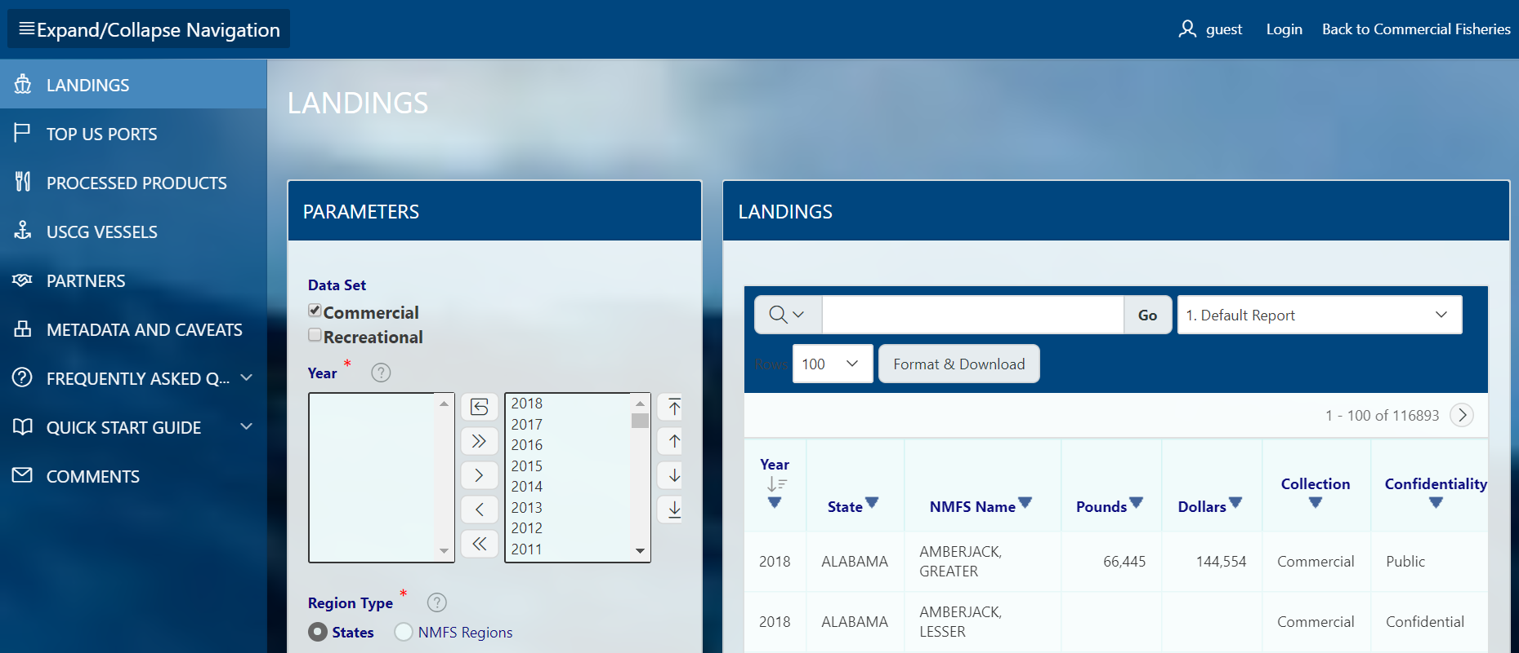

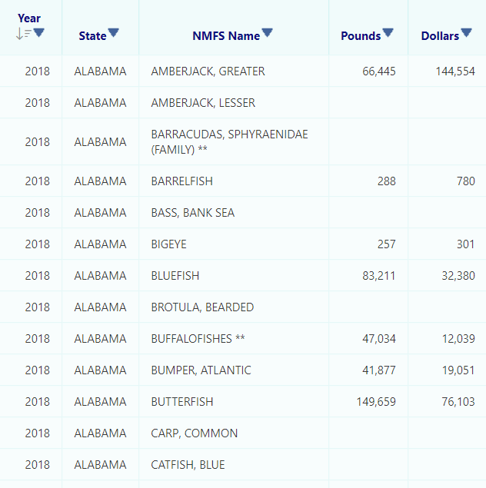
Data Source
Commercial Fisheries
The Tornqvist quantity index requires data on quantity and revenue shares.
We employ landings quantity (pounds) and landings value ($USD) data by year, state, and species.
Notes:
For this analysis, we need how many fish (landings quantity) were caught at their respective landings values. NOAA Fisheries aggregates their data by year, state, and species which is perfect for us.
This data is publicly available for anyone to access.

Slide 10
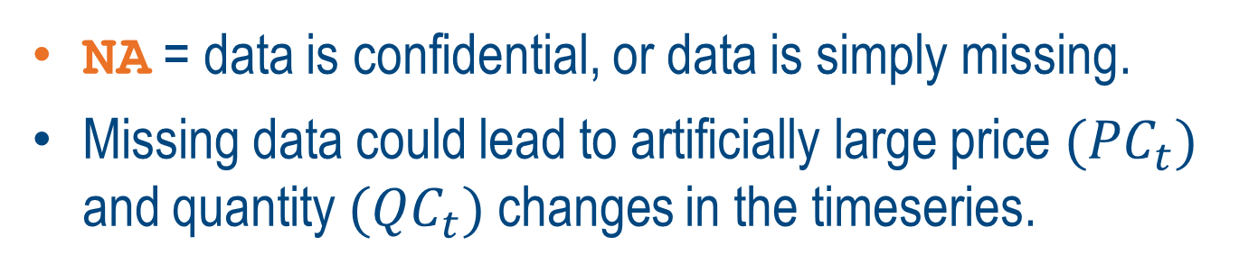
Missing Data
NA = data is confidential, or data is simply missing.
Missing data could lead to artificially large price ${(PC}_{t})$ and quantity ${(QC}_{t})$changes in the timeseries.
 |  | Q Salmon | Q Cod | Q Shrimp | Q Clam | Q Bass | V Salmon | V Cod | V Shrimp | V Clam | V Bass
 | 2007 | 20 | 2000 | 100 | 150 | NA | 100 | NA | 800 | 1000 | 1000
 | 2008 | 20 | 1900 | 120 | 160 | NA | 100 | 2700 | 1000 | 1200 | 1200
 | 2009 | 20 | 2000 | 110 | 140 | NA | 100 | 2900 | 900 | 900 | 900
 | 2010 | 20 | 2500 | 90 | NA | NA | NA | 3000 | 700 | NA | 700
 | 2011 | 10 | NA | 80 | NA | NA | NA | 3100 | 900 | 400 | NA
 | 2012 | 12 | 2300 | 100 | NA | NA | 150 | NA | 1000 | NA | NA
 | 2013 | 11 | 2000 | 100 | NA | NA | 180 | 2800 | 1200 | 1000 | 1000
 | 2014 | 11 | 2300 | 110 | 110 | NA | 170 | 3200 | 1100 | 900 | 900
 | 2015 | 10 | 2400 | 90 | 130 | NA | 200 | 3500 | 1000 | 1000 | 1000
 | 2016 | 15 | 2200 | 100 | 160 | NA | 180 | 3200 | 1200 | 1100 | 1100
If NA = 0,
 | Q1_1Salmon | Q1_2Cod | Q2_1Shrimp | Q2_2Clam | Q1_3Flounder | Q1_4SeaBass | QE0_0Total | QE1_0Finfish | QE2_0Shellfish | V1_1Salmon | V1_2Cod | V2_1Shrimp | V2_2Clam | V1_3Flounder | V1_4SeaBass | VE0_0Total | VE1_0Finfish | VE2_0Shellfish | Q1_0Finfish | V1_0Finfish | VV1_0Finfish | R1_1Salmon | R1_2Cod | R1_4SeaBass | QCW1_1Salmon | QCW1_2Cod | QCW1_4SeaBass | QC1_0Finfish | QI1_0Finfish | Q1_3Flounder | V1_3Flounder | Q2_0Shellfish | V2_0Shellfish | VV2_0Shellfish | R2_1Shrimp | R2_2Clam | QCW2_1Shrimp | QCW2_2Clam | QC2_0Shellfish | QI2_0Shellfish | VV0_0Total | V0_0Total | R1_0Finfish | R2_0Shellfish | QCW1_0Finfish | QCW2_0Shellfish | QC0_0Total | QI0_0Total | QEI0_0Total
2007 | 20 | 2000 | 100 | 150 | NA | 1000 | 3250 | 3000 | 250 | 100 | 2800 | 800 | 1000 | 1000 | 120 | 5600 | 3800 | 1800 | 3000 | 2800 | 3020 | 0.033113 | 0.927152 | 0.039735 | 0 | 0 | 0 | 0 | 0.814264 | NA | 1000 | 250 | 1800 | 1800 | 0.444444 | 0.555556 | 0 | 0 | 0 | 1.091892 | 4820 | 4600 | 0.608696 | 0.391304 | 0 | 0 | 0 | 0.880935 | 1.245211
2008 | 20 | 1900 | 120 | 160 | NA | 1200 | 3380 | 3100 | 280 | 100 | 2700 | 1000 | 1200 | 1200 | 120 | 6220 | 4020 | 2200 | 3100 | 2820 | 2920 | 0.034247 | 0.924658 | 0.041096 | 0 | -0.04749 | 0.007369 | -0.04012 | 0.782239 | NA | 1200 | 280 | 2200 | 2200 | 0.454545 | 0.545455 | 0.081953 | 0.035529 | 0.117481 | 1.228008 | 5120 | 5020 | 0.561753 | 0.438247 | -0.02348 | 0.048728 | 0.025247 | 0.903459 | 1.295019
2009 | 20 | 2000 | 110 | 140 | NA | 900 | 3150 | 2900 | 250 | 100 | 2900 | 900 | 900 | 900 | 110 | 5710 | 3910 | 1800 | 2900 | 3010 | 3110 | 0.032154 | 0.932476 | 0.03537 | 0 | 0.047629 | -0.011 | 0.03663 | 0.811424 | NA | 900 | 250 | 1800 | 1800 | 0.5 | 0.5 | -0.04153 | -0.0698 | -0.11133 | 1.09863 | 4910 | 4810 | 0.62578 | 0.37422 | 0.02175 | -0.04523 | -0.02348 | 0.882497 | 1.206897
2010 | 20 | 2500 | 90 | NA | NA | 900 | 2610 | 2520 | 90 | 100 | 3000 | 700 | NA | NA | 90 | 3890 | 3190 | 700 | 2520 | 3190 | 3190 | 0.031348 | 0.940439 | 0.028213 | 0 | 0.208964 | 0 | 0.208964 | 1 | NA | NA | 90 | 700 | 1600 | 0.4375 | 0.5625 | -0.09406 | 0 | -0.09406 | 1 | 4790 | 3890 | 0.820051 | 0.179949 | 0.151064 | -0.02606 | 0.125 | 1 | 1
2011 | 10 | 2400 | 80 | NA | NA | 900 | 2490 | 2410 | 80 | 100 | 3100 | 900 | NA | NA | 80 | 4180 | 3280 | 900 | 2410 | 3280 | 3280 | 0.030488 | 0.945122 | 0.02439 | -0.02143 | -0.03849 | 0 | -0.05992 | 0.941843 | NA | NA | 80 | 900 | 1800 | 0.5 | 0.5 | -0.05521 | 0 | -0.05521 | 0.946286 | 5080 | 4180 | 0.784689 | 0.215311 | -0.04808 | -0.01091 | -0.05899 | 0.942719 | 0.954023
2012 | 12 | 2300 | 100 | NA | NA | 900 | 2412 | 2312 | 100 | 150 | 2900 | 1000 | NA | NA | 100 | 4150 | 3150 | 1000 | 2312 | 3150 | 3150 | 0.047619 | 0.920635 | 0.031746 | 0.00712 | -0.0397 | 0 | -0.03258 | 0.91165 | NA | NA | 100 | 1000 | 1900 | 0.526316 | 0.473684 | 0.114508 | 0 | 0.114508 | 1.06109 | 5050 | 4150 | 0.759036 | 0.240964 | -0.02515 | 0.026124 | 0.000974 | 0.943638 | 0.924138
2013 | 11 | 2000 | 100 | 140 | NA | 1000 | 3251 | 3011 | 240 | 180 | 2800 | 1200 | 1000 | 1000 | 100 | 6280 | 4080 | 2200 | 3011 | 3080 | 3080 | 0.058442 | 0.909091 | 0.032468 | -0.00461 | -0.12786 | 0.003383 | -0.12909 | 0.801241 | NA | 1000 | 240 | 2200 | 2200 | 0.545455 | 0.454545 | 0 | 0 | 0 | 1.06109 | 5280 | 5280 | 0.583333 | 0.416667 | -0.08665 | 0 | -0.08665 | 0.865317 | 1.245594
2014 | 11 | 2300 | 110 | 110 | NA | 900 | 3431 | 3211 | 220 | 170 | 3200 | 1100 | 900 | 900 | 100 | 6270 | 4270 | 2000 | 3211 | 3370 | 3470 | 0.048991 | 0.92219 | 0.028818 | 0 | 0.127972 | -0.00323 | 0.124743 | 0.907691 | NA | 900 | 220 | 2000 | 2000 | 0.55 | 0.45 | 0.052204 | -0.10907 | -0.05687 | 1.002433 | 5470 | 5370 | 0.627561 | 0.372439 | 0.075525 | -0.02244 | 0.053088 | 0.912497 | 1.314559
2015 | 10 | 2400 | 90 | 130 | NA | 1000 | 3630 | 3410 | 220 | 200 | 3500 | 1000 | 1000 | 1000 | 100 | 6700 | 4700 | 2000 | 3410 | 3700 | 3800 | 0.052632 | 0.921053 | 0.026316 | -0.00484 | 0.039224 | 0.002904 | 0.037285 | 0.942174 | NA | 1000 | 220 | 2000 | 2000 | 0.5 | 0.5 | -0.10535 | 0.079351 | -0.026 | 0.976704 | 5800 | 5700 | 0.649123 | 0.350877 | 0.023801 | -0.0094 | 0.014397 | 0.925729 | 1.390805
2016 | 15 | 2200 | 100 | 160 | NA | 1100 | 3575 | 3315 | 260 | 180 | 3200 | 1200 | 1100 | 1100 | 100 | 6780 | 4480 | 2300 | 3315 | 3380 | 3480 | 0.051724 | 0.91954 | 0.028736 | 0.021156 | -0.08008 | 0.002623 | -0.0563 | 0.890598 | NA | 1100 | 260 | 2300 | 2300 | 0.521739 | 0.478261 | 0.053825 | 0.101563 | 0.155388 | 1.140899 | 5780 | 5680 | 0.59507 | 0.40493 | -0.03502 | 0.058722 | 0.0237 | 0.947931 | 1.369732
Notes:
NA in the commercial fisheries dataset does not mean 0, but rather that the data may be confidential (following the rule of 3) or simply be missing. This can be a serious issue here, as missing data could lead to artificially large price ${(PC}_{t})$ and quantity ${(QC}_{t})$changes for years in the timeseries.
There are a lot of NAs in this dataset. Some data columns are completely filled with NA and even those that are not --
[Click] you can see here how this fictitious value of cod is clearly falsely misshapen by the NAs in the dataset.

Slide 11
Missing Data
Instituted a % missing data threshold
Ex. 40% of the V or Q data was missing in a timeseries, the columns were removed from the analysis.
 |  | Q Salmon | Q Cod | Q Shrimp | Q Clam | Q Bass | V Salmon | V Cod | V Shrimp | V Clam | V Bass
 | 2007 | 20 | 2000 | 100 | 150 | NA | 100 | NA | 800 | 1000 | 1000
 | 2008 | 20 | 1900 | 120 | 160 | NA | 100 | 2700 | 1000 | 1200 | 1200
 | 2009 | 20 | 2000 | 110 | 140 | NA | 100 | 2900 | 900 | 900 | 900
 | 2010 | 20 | 2500 | 90 | NA | NA | NA | 3000 | 700 | NA | 700
 | 2011 | 10 | NA | 80 | NA | NA | NA | 3100 | 900 | 400 | NA
 | 2012 | 12 | 2300 | 100 | NA | NA | 150 | NA | 1000 | NA | NA
 | 2013 | 11 | 2000 | 100 | NA | NA | 180 | 2800 | 1200 | 1000 | 1000
 | 2014 | 11 | 2300 | 110 | 110 | NA | 170 | 3200 | 1100 | 900 | 900
 | 2015 | 10 | 2400 | 90 | 130 | NA | 200 | 3500 | 1000 | 1000 | 1000
 | 2016 | 15 | 2200 | 100 | 160 | NA | 180 | 3200 | 1200 | 1100 | 1100
Since these Q were removed… so is V
 | Q1_1Salmon | Q1_2Cod | Q2_1Shrimp | Q2_2Clam | Q1_3Flounder | Q1_4SeaBass | QE0_0Total | QE1_0Finfish | QE2_0Shellfish | V1_1Salmon | V1_2Cod | V2_1Shrimp | V2_2Clam | V1_3Flounder | V1_4SeaBass | VE0_0Total | VE1_0Finfish | VE2_0Shellfish | Q1_0Finfish | V1_0Finfish | VV1_0Finfish | R1_1Salmon | R1_2Cod | R1_4SeaBass | QCW1_1Salmon | QCW1_2Cod | QCW1_4SeaBass | QC1_0Finfish | QI1_0Finfish | Q1_3Flounder | V1_3Flounder | Q2_0Shellfish | V2_0Shellfish | VV2_0Shellfish | R2_1Shrimp | R2_2Clam | QCW2_1Shrimp | QCW2_2Clam | QC2_0Shellfish | QI2_0Shellfish | VV0_0Total | V0_0Total | R1_0Finfish | R2_0Shellfish | QCW1_0Finfish | QCW2_0Shellfish | QC0_0Total | QI0_0Total | QEI0_0Total
2007 | 20 | 2000 | 100 | 150 | NA | 1000 | 3250 | 3000 | 250 | 100 | 2800 | 800 | 1000 | 1000 | 120 | 5600 | 3800 | 1800 | 3000 | 2800 | 3020 | 0.033113 | 0.927152 | 0.039735 | 0 | 0 | 0 | 0 | 0.814264 | NA | 1000 | 250 | 1800 | 1800 | 0.444444 | 0.555556 | 0 | 0 | 0 | 1.091892 | 4820 | 4600 | 0.608696 | 0.391304 | 0 | 0 | 0 | 0.880935 | 1.245211
2008 | 20 | 1900 | 120 | 160 | NA | 1200 | 3380 | 3100 | 280 | 100 | 2700 | 1000 | 1200 | 1200 | 120 | 6220 | 4020 | 2200 | 3100 | 2820 | 2920 | 0.034247 | 0.924658 | 0.041096 | 0 | -0.04749 | 0.007369 | -0.04012 | 0.782239 | NA | 1200 | 280 | 2200 | 2200 | 0.454545 | 0.545455 | 0.081953 | 0.035529 | 0.117481 | 1.228008 | 5120 | 5020 | 0.561753 | 0.438247 | -0.02348 | 0.048728 | 0.025247 | 0.903459 | 1.295019
2009 | 20 | 2000 | 110 | 140 | NA | 900 | 3150 | 2900 | 250 | 100 | 2900 | 900 | 900 | 900 | 110 | 5710 | 3910 | 1800 | 2900 | 3010 | 3110 | 0.032154 | 0.932476 | 0.03537 | 0 | 0.047629 | -0.011 | 0.03663 | 0.811424 | NA | 900 | 250 | 1800 | 1800 | 0.5 | 0.5 | -0.04153 | -0.0698 | -0.11133 | 1.09863 | 4910 | 4810 | 0.62578 | 0.37422 | 0.02175 | -0.04523 | -0.02348 | 0.882497 | 1.206897
2010 | 20 | 2500 | 90 | NA | NA | 900 | 2610 | 2520 | 90 | 100 | 3000 | 700 | NA | NA | 90 | 3890 | 3190 | 700 | 2520 | 3190 | 3190 | 0.031348 | 0.940439 | 0.028213 | 0 | 0.208964 | 0 | 0.208964 | 1 | NA | NA | 90 | 700 | 1600 | 0.4375 | 0.5625 | -0.09406 | 0 | -0.09406 | 1 | 4790 | 3890 | 0.820051 | 0.179949 | 0.151064 | -0.02606 | 0.125 | 1 | 1
2011 | 10 | 2400 | 80 | NA | NA | 900 | 2490 | 2410 | 80 | 100 | 3100 | 900 | NA | NA | 80 | 4180 | 3280 | 900 | 2410 | 3280 | 3280 | 0.030488 | 0.945122 | 0.02439 | -0.02143 | -0.03849 | 0 | -0.05992 | 0.941843 | NA | NA | 80 | 900 | 1800 | 0.5 | 0.5 | -0.05521 | 0 | -0.05521 | 0.946286 | 5080 | 4180 | 0.784689 | 0.215311 | -0.04808 | -0.01091 | -0.05899 | 0.942719 | 0.954023
2012 | 12 | 2300 | 100 | NA | NA | 900 | 2412 | 2312 | 100 | 150 | 2900 | 1000 | NA | NA | 100 | 4150 | 3150 | 1000 | 2312 | 3150 | 3150 | 0.047619 | 0.920635 | 0.031746 | 0.00712 | -0.0397 | 0 | -0.03258 | 0.91165 | NA | NA | 100 | 1000 | 1900 | 0.526316 | 0.473684 | 0.114508 | 0 | 0.114508 | 1.06109 | 5050 | 4150 | 0.759036 | 0.240964 | -0.02515 | 0.026124 | 0.000974 | 0.943638 | 0.924138
2013 | 11 | 2000 | 100 | 140 | NA | 1000 | 3251 | 3011 | 240 | 180 | 2800 | 1200 | 1000 | 1000 | 100 | 6280 | 4080 | 2200 | 3011 | 3080 | 3080 | 0.058442 | 0.909091 | 0.032468 | -0.00461 | -0.12786 | 0.003383 | -0.12909 | 0.801241 | NA | 1000 | 240 | 2200 | 2200 | 0.545455 | 0.454545 | 0 | 0 | 0 | 1.06109 | 5280 | 5280 | 0.583333 | 0.416667 | -0.08665 | 0 | -0.08665 | 0.865317 | 1.245594
2014 | 11 | 2300 | 110 | 110 | NA | 900 | 3431 | 3211 | 220 | 170 | 3200 | 1100 | 900 | 900 | 100 | 6270 | 4270 | 2000 | 3211 | 3370 | 3470 | 0.048991 | 0.92219 | 0.028818 | 0 | 0.127972 | -0.00323 | 0.124743 | 0.907691 | NA | 900 | 220 | 2000 | 2000 | 0.55 | 0.45 | 0.052204 | -0.10907 | -0.05687 | 1.002433 | 5470 | 5370 | 0.627561 | 0.372439 | 0.075525 | -0.02244 | 0.053088 | 0.912497 | 1.314559
2015 | 10 | 2400 | 90 | 130 | NA | 1000 | 3630 | 3410 | 220 | 200 | 3500 | 1000 | 1000 | 1000 | 100 | 6700 | 4700 | 2000 | 3410 | 3700 | 3800 | 0.052632 | 0.921053 | 0.026316 | -0.00484 | 0.039224 | 0.002904 | 0.037285 | 0.942174 | NA | 1000 | 220 | 2000 | 2000 | 0.5 | 0.5 | -0.10535 | 0.079351 | -0.026 | 0.976704 | 5800 | 5700 | 0.649123 | 0.350877 | 0.023801 | -0.0094 | 0.014397 | 0.925729 | 1.390805
2016 | 15 | 2200 | 100 | 160 | NA | 1100 | 3575 | 3315 | 260 | 180 | 3200 | 1200 | 1100 | 1100 | 100 | 6780 | 4480 | 2300 | 3315 | 3380 | 3480 | 0.051724 | 0.91954 | 0.028736 | 0.021156 | -0.08008 | 0.002623 | -0.0563 | 0.890598 | NA | 1100 | 260 | 2300 | 2300 | 0.521739 | 0.478261 | 0.053825 | 0.101563 | 0.155388 | 1.140899 | 5780 | 5680 | 0.59507 | 0.40493 | -0.03502 | 0.058722 | 0.0237 | 0.947931 | 1.369732
Notes:
So first thing we did was to take care of columns that were mostly made of NAs. We instituted a % missing data threshold.
[Click] Here, these columns have too few data according to a 40% threshold we’ve instituted, so we are simply going to remove that data. Honestly, what could data with that much missing really tell us and at what point are we just making the data up to make up for what is missing?

Slide 12

Missing Data
And any other missing data was imputed* with the next closest value.
*Assuming missing values have similar values to those near them.
 |  | Q Salmon | Q Cod | Q Shrimp | Q Clam | Q Bass | V Salmon | V Cod | V Shrimp | V Clam | V Bass
 | 2007 | 20 | 2000 | 100 | 150 | NA | 100 | NA | 800 | 1000 | 1000
 | 2008 | 20 | 1900 | 120 | 160 | NA | 100 | 2700 | 1000 | 1200 | 1200
 | 2009 | 20 | 2000 | 110 | 140 | NA | 100 | 2900 | 900 | 900 | 900
 | 2010 | 20 | 2500 | 90 | NA | NA | NA | 3000 | 700 | NA | 700
 | 2011 | 10 | NA | 80 | NA | NA | NA | 3100 | 900 | 400 | NA
 | 2012 | 12 | 2300 | 100 | NA | NA | 150 | NA | 1000 | NA | NA
 | 2013 | 11 | 2000 | 100 | NA | NA | 180 | 2800 | 1200 | 1000 | 1000
 | 2014 | 11 | 2300 | 110 | 110 | NA | 170 | 3200 | 1100 | 900 | 900
 | 2015 | 10 | 2400 | 90 | 130 | NA | 200 | 3500 | 1000 | 1000 | 1000
 | 2016 | 15 | 2200 | 100 | 160 | NA | 180 | 3200 | 1200 | 1100 | 1100
2700
If NA is imputed,
Output = Landings
 | Q1_1Salmon | Q1_2Cod | Q2_1Shrimp | Q2_2Clam | Q1_3Flounder | Q1_4SeaBass | QE0_0Total | QE1_0Finfish | QE2_0Shellfish | V1_1Salmon | V1_2Cod | V2_1Shrimp | V2_2Clam | V1_3Flounder | V1_4SeaBass | VE0_0Total | VE1_0Finfish | VE2_0Shellfish | Q1_0Finfish | V1_0Finfish | VV1_0Finfish | R1_1Salmon | R1_2Cod | R1_4SeaBass | QCW1_1Salmon | QCW1_2Cod | QCW1_4SeaBass | QC1_0Finfish | QI1_0Finfish | Q1_3Flounder | V1_3Flounder | Q2_0Shellfish | V2_0Shellfish | VV2_0Shellfish | R2_1Shrimp | R2_2Clam | QCW2_1Shrimp | QCW2_2Clam | QC2_0Shellfish | QI2_0Shellfish | VV0_0Total | V0_0Total | R1_0Finfish | R2_0Shellfish | QCW1_0Finfish | QCW2_0Shellfish | QC0_0Total | QI0_0Total | QEI0_0Total
2007 | 20 | 2000 | 100 | 150 | NA | 1000 | 3250 | 3000 | 250 | 100 | 2800 | 800 | 1000 | 1000 | 120 | 5600 | 3800 | 1800 | 3000 | 2800 | 3020 | 0.033113 | 0.927152 | 0.039735 | 0 | 0 | 0 | 0 | 0.814264 | NA | 1000 | 250 | 1800 | 1800 | 0.444444 | 0.555556 | 0 | 0 | 0 | 1.091892 | 4820 | 4600 | 0.608696 | 0.391304 | 0 | 0 | 0 | 0.880935 | 1.245211
2008 | 20 | 1900 | 120 | 160 | NA | 1200 | 3380 | 3100 | 280 | 100 | 2700 | 1000 | 1200 | 1200 | 120 | 6220 | 4020 | 2200 | 3100 | 2820 | 2920 | 0.034247 | 0.924658 | 0.041096 | 0 | -0.04749 | 0.007369 | -0.04012 | 0.782239 | NA | 1200 | 280 | 2200 | 2200 | 0.454545 | 0.545455 | 0.081953 | 0.035529 | 0.117481 | 1.228008 | 5120 | 5020 | 0.561753 | 0.438247 | -0.02348 | 0.048728 | 0.025247 | 0.903459 | 1.295019
2009 | 20 | 2000 | 110 | 140 | NA | 900 | 3150 | 2900 | 250 | 100 | 2900 | 900 | 900 | 900 | 110 | 5710 | 3910 | 1800 | 2900 | 3010 | 3110 | 0.032154 | 0.932476 | 0.03537 | 0 | 0.047629 | -0.011 | 0.03663 | 0.811424 | NA | 900 | 250 | 1800 | 1800 | 0.5 | 0.5 | -0.04153 | -0.0698 | -0.11133 | 1.09863 | 4910 | 4810 | 0.62578 | 0.37422 | 0.02175 | -0.04523 | -0.02348 | 0.882497 | 1.206897
2010 | 20 | 2500 | 90 | NA | NA | 900 | 2610 | 2520 | 90 | 100 | 3000 | 700 | NA | NA | 90 | 3890 | 3190 | 700 | 2520 | 3190 | 3190 | 0.031348 | 0.940439 | 0.028213 | 0 | 0.208964 | 0 | 0.208964 | 1 | NA | NA | 90 | 700 | 1600 | 0.4375 | 0.5625 | -0.09406 | 0 | -0.09406 | 1 | 4790 | 3890 | 0.820051 | 0.179949 | 0.151064 | -0.02606 | 0.125 | 1 | 1
2011 | 10 | 2400 | 80 | NA | NA | 900 | 2490 | 2410 | 80 | 100 | 3100 | 900 | NA | NA | 80 | 4180 | 3280 | 900 | 2410 | 3280 | 3280 | 0.030488 | 0.945122 | 0.02439 | -0.02143 | -0.03849 | 0 | -0.05992 | 0.941843 | NA | NA | 80 | 900 | 1800 | 0.5 | 0.5 | -0.05521 | 0 | -0.05521 | 0.946286 | 5080 | 4180 | 0.784689 | 0.215311 | -0.04808 | -0.01091 | -0.05899 | 0.942719 | 0.954023
2012 | 12 | 2300 | 100 | NA | NA | 900 | 2412 | 2312 | 100 | 150 | 2900 | 1000 | NA | NA | 100 | 4150 | 3150 | 1000 | 2312 | 3150 | 3150 | 0.047619 | 0.920635 | 0.031746 | 0.00712 | -0.0397 | 0 | -0.03258 | 0.91165 | NA | NA | 100 | 1000 | 1900 | 0.526316 | 0.473684 | 0.114508 | 0 | 0.114508 | 1.06109 | 5050 | 4150 | 0.759036 | 0.240964 | -0.02515 | 0.026124 | 0.000974 | 0.943638 | 0.924138
2013 | 11 | 2000 | 100 | 140 | NA | 1000 | 3251 | 3011 | 240 | 180 | 2800 | 1200 | 1000 | 1000 | 100 | 6280 | 4080 | 2200 | 3011 | 3080 | 3080 | 0.058442 | 0.909091 | 0.032468 | -0.00461 | -0.12786 | 0.003383 | -0.12909 | 0.801241 | NA | 1000 | 240 | 2200 | 2200 | 0.545455 | 0.454545 | 0 | 0 | 0 | 1.06109 | 5280 | 5280 | 0.583333 | 0.416667 | -0.08665 | 0 | -0.08665 | 0.865317 | 1.245594
2014 | 11 | 2300 | 110 | 110 | NA | 900 | 3431 | 3211 | 220 | 170 | 3200 | 1100 | 900 | 900 | 100 | 6270 | 4270 | 2000 | 3211 | 3370 | 3470 | 0.048991 | 0.92219 | 0.028818 | 0 | 0.127972 | -0.00323 | 0.124743 | 0.907691 | NA | 900 | 220 | 2000 | 2000 | 0.55 | 0.45 | 0.052204 | -0.10907 | -0.05687 | 1.002433 | 5470 | 5370 | 0.627561 | 0.372439 | 0.075525 | -0.02244 | 0.053088 | 0.912497 | 1.314559
2015 | 10 | 2400 | 90 | 130 | NA | 1000 | 3630 | 3410 | 220 | 200 | 3500 | 1000 | 1000 | 1000 | 100 | 6700 | 4700 | 2000 | 3410 | 3700 | 3800 | 0.052632 | 0.921053 | 0.026316 | -0.00484 | 0.039224 | 0.002904 | 0.037285 | 0.942174 | NA | 1000 | 220 | 2000 | 2000 | 0.5 | 0.5 | -0.10535 | 0.079351 | -0.026 | 0.976704 | 5800 | 5700 | 0.649123 | 0.350877 | 0.023801 | -0.0094 | 0.014397 | 0.925729 | 1.390805
2016 | 15 | 2200 | 100 | 160 | NA | 1100 | 3575 | 3315 | 260 | 180 | 3200 | 1200 | 1100 | 1100 | 100 | 6780 | 4480 | 2300 | 3315 | 3380 | 3480 | 0.051724 | 0.91954 | 0.028736 | 0.021156 | -0.08008 | 0.002623 | -0.0563 | 0.890598 | NA | 1100 | 260 | 2300 | 2300 | 0.521739 | 0.478261 | 0.053825 | 0.101563 | 0.155388 | 1.140899 | 5780 | 5680 | 0.59507 | 0.40493 | -0.03502 | 0.058722 | 0.0237 | 0.947931 | 1.369732
3100
Notes:
Now with those offending columns of missing data gone, we can go after the loose, infrequent, NAs.
[Click] Here we impute the values from the closest value
[Click] and harkening back to our previous example, the fictitious code value data looks a lot more realistic!

Slide 13
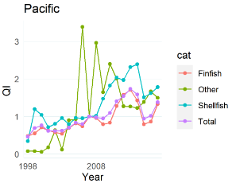
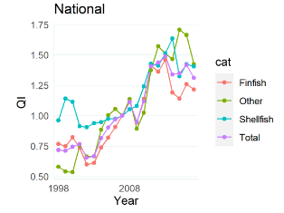
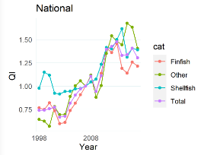
Missing Data Ex. Price Model
National
No data removed (n_{used}=1,068)
National
Data series with 60% missing were removed (n_{used}=697)
Removed 371 species
Removed:
Fin 219
Shell: 85
Other: 67
Looks almost unchanged…
Larger data sets were “cushioned”
~35% of species had almost no impact on the result
Notes:
When we apply these practices for missing data to real data examples, we see that the removal of nearly 400 species data results in a plot for quantity index (one of our targeted end products) almost the same to one where no data was removed. This provides evidence that those removed data weren’t really contributing much to the results. This is also a large dataset such that the impact of the data removed (35% of the original data) is cushioned by how much data is remaining.

Slide 14
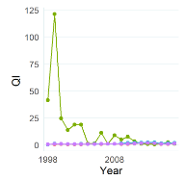
Missing Data Ex. Price Model
Pacific Region
No data removed (n_{used}=205)
Pacific Region
Data series with 40% missing were removed (n_{used}=147)
Removed 58 species
1997-2017, no data removed
1997-2017,. pctmiss = .60%
Very different results
Smaller data sets produced sensible results when missing data was removed!
Notes:
On the other hand, the removal of 58 species (approximately 25% of the original data) radically changes this regional plot. The y-axis is displaying beyond-reasoble values and the spike in the “Other” category can’t possibly be correct. With the percent missing threshold implemented, QI values appear to be in a much more sensible range.

Slide 15
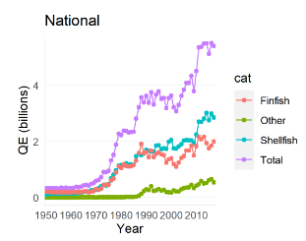
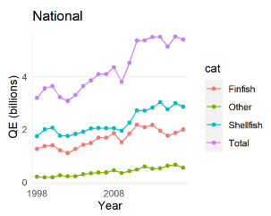
Timeseries Reporting Consistency Ex. Price Model
National
Whole time series
(1950-2017)
National
(1997-2017)
Simple Sum Q (Billions)
Simple Sum Q (Billions)
Periods of improved reporting; not real changes in Q
Data are more realistic when data is subset
Notes:
On to our next issue: Consistent reporting throughout the timeseries.
[Click] looking simply at the summed quantity for each category and the entire fishery, there have been several periods of improved reporting, such that the increasing trend is so steep and is not indicative of real increases in the quantity of fish caught from 1950 (when data was first started to be collected) to today (2017).
[Click] If we just take the last part of that timeline, the trend seems more level and reasonable.

Slide 16
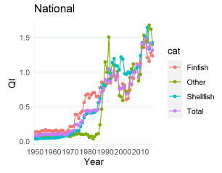
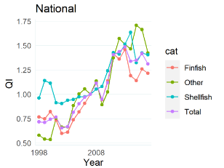
Timeseries Reporting Consistency Ex. Price Model
National
Whole time series
(1950-2017)
National
(1997-2017)
Less data removed via % missing threshold!
Place | Category | Total Count | Removed Count | Used Count
National | Finfish | 729 | 457 | 272
 | Other | 133 | 109 | 24
 | Shellfish | 247 | 175 | 72
Place | Category | Total Count | Removed Count | Used Count
National | Finfish | 703 | 107 | 596
 | Other | 125 | 48 | 77
 | Shellfish | 240 | 43 | 197
Notes:
If we look at the quantity index result, we see that much of our missing data is pre-1990 and our analysis inherently removes less data when we subset, giving us more species data to work with.

Slide 17







Defining Species Categories
Vertebrates
Specific or broad?
Theoretically, categories should group species with similar fishing costs, but that can be difficult to define.
Species in the same taxonomic group are more likely to be caught in similar ways…?
Bony Fish
“Fish”
Cartilaginous Fish
Not Animals
Animalia
Invertebrates
Crustaceans
Plants
“Shellfish”
Mollusks
Notes:
The next question is something we are still thinking about: How to define our species categories. These can be specific or broad
[Click] Theoretically, categories should group species with similar economic impact (e.g., fishing costs) which can be difficult to define.
It is possible that we might be able to use taxonomic group as a proxy for this since species in the same taxonomic group are more likely to be caught in similar ways. (an idea that is very pleasing to the biologist in me!)

Slide 18

Defining Species Categories
1. “Finfish”, “Shellfish”, and “Other”
Pro: Used in Fisheries Economics of the US
Con: Over-generalized
“Shellfish” = all invertebrates
“Finfish” = all vertebrates
“Other” = non-animalia
2. Taxonomically using their Taxonomic Serial Numbers
Pro: Helps identify where weird data is.
Pro: May provide a more accurate and descriptive result.
Con: Leads to less data available to each category.
Notes:
More specifically, we applied two methods:
We used the same species groupings as were used in Fisheries Economics of the US report. This could work because there is a precedent for using this species split up, but it is fairly over-generalized. “Shellfish” is not really the same as saying “all invertebrates”, for example.
[Click] Alternatively, thanks to renewed data managing efforts done by ST1, we now have ITSN numbers associated with each species, and with some fancy footwork, can resort these species into a variety of taxonomically-relevant groups. However, with the more categories we have, the less data we have for each category.

Slide 19
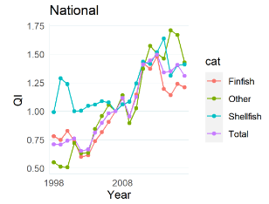
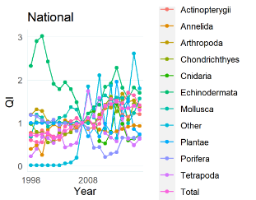
Defining Species Categories
1. “Finfish” “Shellfish”, and “Other”
2. Taxonomically using their Taxonomic Serial Numbers
Tells us that it is a more complicated than a simply increasing trend
Notes:
These plots were created using the same data, just by splitting the categories up differently. We can see that the QI is increasing in the first plot using the FEUS categories and that the second plot using the taxomcially defined species has species increasing and decreasing.
{Click] This may be a key to better seeing what is actually going on in the data.

Slide 20
Preliminary Results
Output = Landings
For each species
Determine which species have enough data
For each Fishing Category
For the Entire Fishing Sector
Revenue change
Implicit quantity index
Revenue-share
Revenue-share weighted price changes
Price
Revenue index
Revenue-share
Revenue-share weighted
Implicit quantity index
Revenue index
Revenue change
For each species
Determine which species have enough data
Quantity-share weighted quantity changes by quantity
For each Fishing Category
Revenue change
For the Entire Fishing Sector
Quantity change
Quantity-share
Revenue-share weighted
Quantity index
Revenue index
Revenue-share

Slide 21




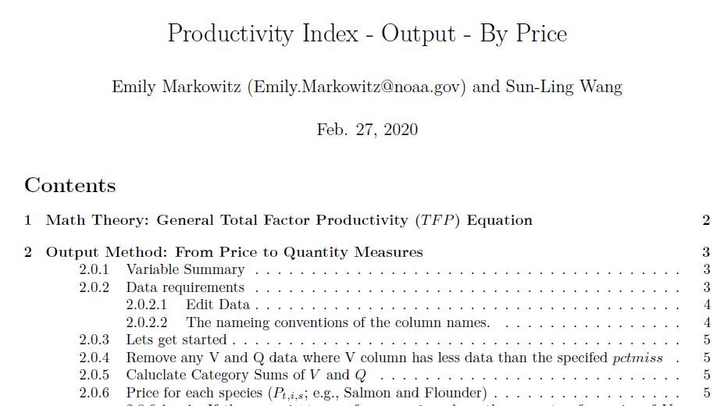
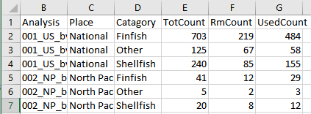
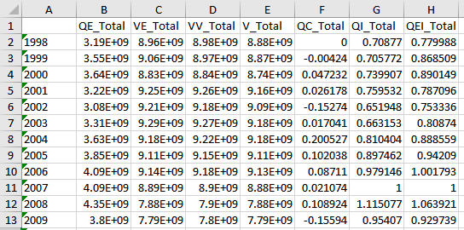
Analysis Workflow and Products
Documentation of each method
Report on run issues, analytics, and data loss
Figures of each major variable
Summary spreadsheets of results for each region
Notes:
All analysis was done in R, as opposed to excel where it has been done previously, because of its ability to dynamically deal with these data issues and streamline the analysis. Also, R is able to output more than just csv results, but also, …
Produces documentation for both methods (using price and quantity).
Automatically produces figures and spreadsheets of results for each region.
Documents warnings, which data was used, and species included in analysis run reports.

Slide 22
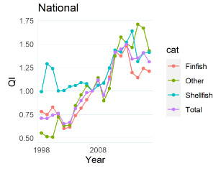
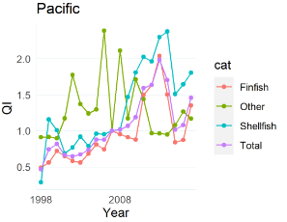
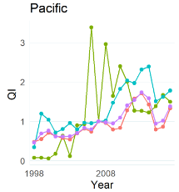
Comparing the models:
Q Models remove more data
Place | Category | Total Count | Removed Count | Used Count
National | Finfish | 703 | 219 | 484
 | Other | 125 | 67 | 58
 | Shellfish | 240 | 85 | 155
Pacific | Finfish | 145 | 32 | 113
 | Other | 18 | 7 | 11
 | Shellfish | 42 | 19 | 23
Quantity
Models behave similarly
Place | Category | Total Count | Removed Count | Used Count
National | Finfish | 703 | 107 | 596
 | Other | 125 | 48 | 77
 | Shellfish | 240 | 43 | 197
Pacific | Finfish | 145 | 20 | 125
 | Other | 18 | 6 | 12
 | Shellfish | 42 | 9 | 33
Price
Method: Price Quantity
Notes:
On this slide, the I’ll focus on the fish/shellfish categories but this rings true for the taxonomically-divided groups, as well. On the top are the QI results for the US data and the Pacific using the quantity model method. On the bottom, it’s the same set up, except that these are the results from the price-model method.
Models behave similarly, though there are more obvious differences in the Pacific results.
Interestingly, the quantity-model method appears to remove more data than the price model method.

Slide 23
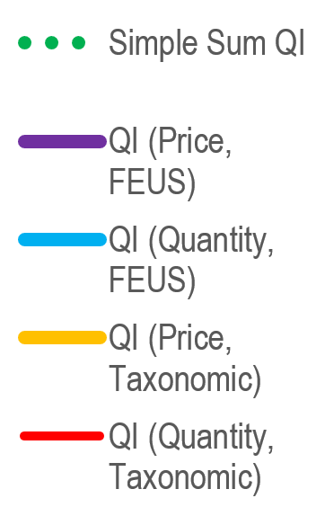
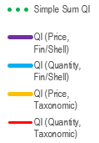
National Quantity Index
At the national level, there is strong agreement between the different Quantity and Price models
Notes:
If I quickly compare the total QI estimates for each of the different models [quantity model using the Fish/shell/other categories (as they are in FEUS) in blue, quantity model using the taxonomic categories in red, price model using the fish/shell categories in purple, and price model using the taxonomic categories in yellow] (just remember, cool colors for FEUS, warm colors for taxonomic) compared to the green dotted line showing the simple sum of Q over time, we see that…
At the national level, there is agreement between price and quantity models

Slide 24
Regional Quantity Index
Quantity models appear to exaggerate quantity change
Notes:
This agreement between models is more or less pretty consistent for the regional models, though we can see more differences between the quantity and price model results.
It’s interesting how the tails of the Hawaii are really stratify the quantity and price models. You’ll see this in the pacific and the atlantic regions, but Quantity models appear to exaggerate quantity change .
Something we want to explore more.

Slide 25
Regional Quantity Index
Notes:
As I mentioned, there is that same issue with the quantity change in New England (in particular) and in the SA and MA.

Slide 26
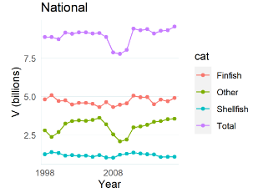
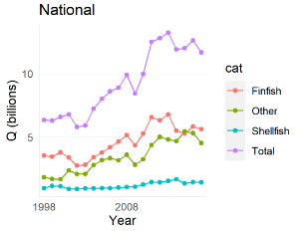
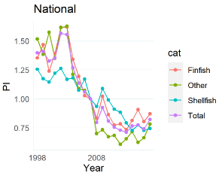
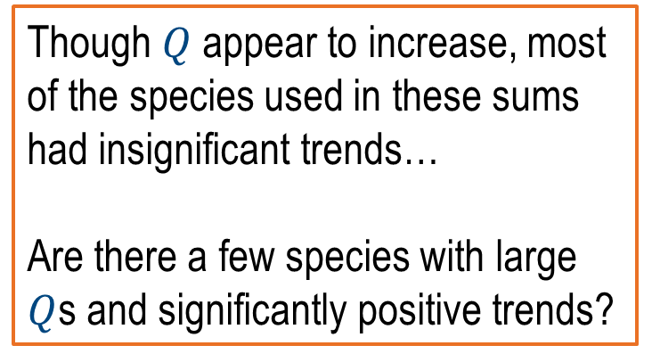

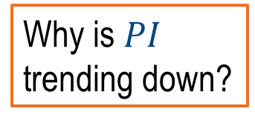
Price Index Estimates Price Model
May want to compare with an analysis focused on more targeted species?
PI ~ V $÷$ Q
???
???
???
???
V (Billions)
Q (Billions)
Why is $PI$ trending down?
Category | Variable | Slope | Frequency
Finfish | P | Insig | 132
 | P | Sig Neg | 315
 | P | Sig Pos | 34
Other | P | Insig | 20
 | P | Sig Neg | 29
 | P | Sig Pos | 9
Shellfish | P | Insig | 57
 | P | Sig Neg | 72
 | P | Sig Pos | 25
Variable | Slope | Frequency
V | Insig | 200
V | Sig Neg | 177
V | Sig Pos | 104
V | Insig | 22
V | Sig Neg | 25
V | Sig Pos | 11
V | Insig | 66
V | Sig Neg | 54
V | Sig Pos | 34
Variable | Slope | Frequency
Q | Insig | 255
Q | Sig Neg | 94
Q | Sig Pos | 132
Q | Insig | 35
Q | Sig Neg | 11
Q | Sig Pos | 12
Q | Insig | 84
Q | Sig Neg | 31
Q | Sig Pos | 39
Though $Q$ appear to increase, most of the species used in these sums had insignificant trends…
Are there a few species with large $Q$s and significantly positive trends?
Notes:
Specific to Price Models, we also develop Price Indices. Something we consistently noticed across the models and regions was that the PI was often decreasing. That’s not what one might expect, right?
[Click] It is true, as we can see, that the majority of P data that went into this Price Index were significantly negative, but why?
[Click] When we look at the V and Q (considering that, crudely, P= V/Q), we see that
[Click]Though $Q$ appear to increase, most of the species used in these sums had insignificant trends…
?? Are there a few species with large $Q$s and significantly positive trends?
[Click] ?This May mean we will want to compare with an analysis focused on more targeted species?

Slide 27
Future Considerations
Run an analysis to determine appropriate “percent missing data” threshold.
Develop a “minimum number of data for a category” threshold.
Should “Other”/”Uncategorized” be included?
Assuming these are not target species, does it provide insight into productivity measurements?
Develop analysis where species with smaller quantities are removed.
Notes:
Run an analysis to determine appropriate “percent missing data” threshold.
Develop a “minimum number of data for a category” threshold.
Should “Other”/”Uncategorized” be included?
Assuming these are not target species, does it provide insight into productivity measurements?
Develop analysis where species with smaller quantities are removed to focus on target species.

Slide 28



QUESTIONS?
Special thanks to Rita Curtis and other collaborators.
Emily.Markowitz@noaa.gov
@EmilyHMarkowitz
@EmilyHMarkowitz
Notes:
With that I’ll take any questions, comments, or insight! If you have any questions or want to learn more, feel free to contact me by email or by any of my social media handles.
Thanks!

Slide 29
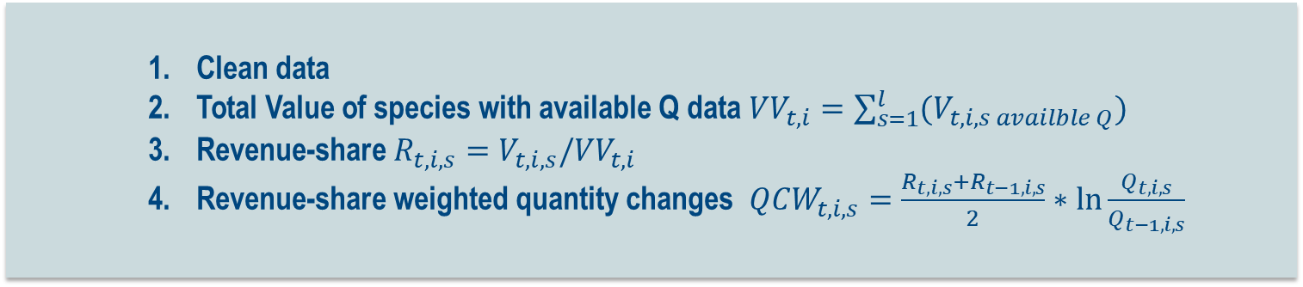
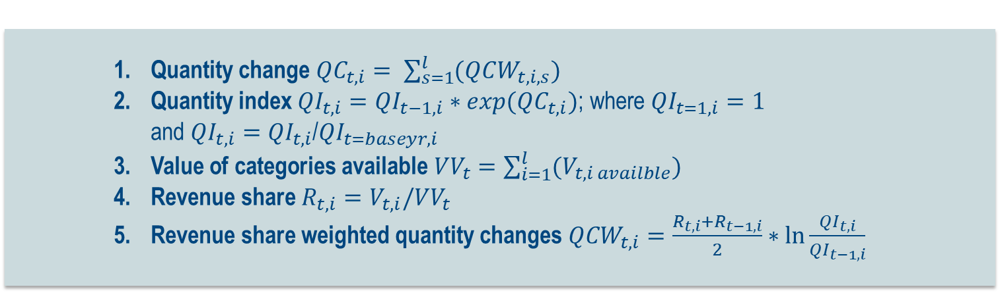
Output Measurement 2: Directly from Quantity Data
Clean data
Total Value of species with available Q data ${VV}_{t,i}=\sum_{s=1}^{l}{(V_{t,i,s availble Q})}$
Revenue-share $R_{t,i,s}=V_{t,i,s}/{VV}_{t,i}$
Revenue-share weighted quantity changes ${QCW}_{t,i,s}=\frac{R_{t,i,s}+R_{t−1,i,s}}{2}∗\ln{\frac{Q_{t,i,s}}{Q_{t−1,i,s}}}$
For each Species (s)
Quantity change ${QC}_{t,i}= \sum_{s=1}^{l}{(QCW_{t,i,s})}$
Quantity index ${QI}_{t,i}=QI_{t−1,i}∗exp(QC_{t,i})$; where ${QI}_{t=1,i}=1$ and ${QI}_{t, i}={QI}_{t, i}$/${QI}_{t=baseyr, i}$
Value of categories available ${VV}_{t}=\sum_{i=1}^{l}{(V_{t,i availble})}$
Revenue share $R_{t,i}=V_{t,i}/{VV}_{t}$
Revenue share weighted quantity changes ${QCW}_{t,i}=\frac{R_{t,i}+R_{t−1,i}}{2}∗\ln{\frac{{QI}_{t,i}}{{QI}_{t−1,i}}}$
For each Fishery Category (i)
Quantity change ${QC}_{t}= \sum_{i=1}^{l}{(QCW_{t,i})}$
Quantity index ${QI}_{t}=QI_{t−1}∗exp(QC_{t})$; where ${QI}_{t=1}=1$ and ${QI}_{t,}={QI}_{t,}$/${QI}_{t=baseyr,}$
For the Entire Commercial Fishing Sector

Slide 30
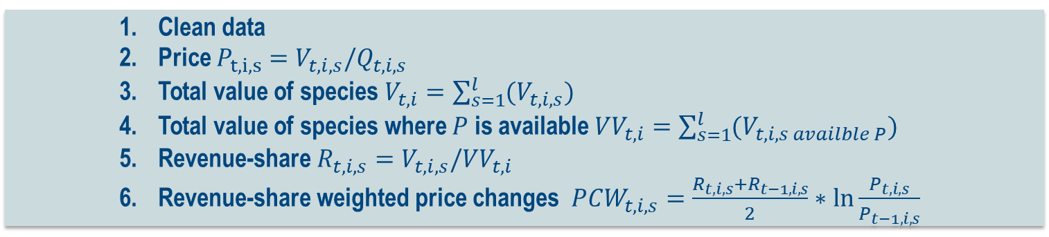
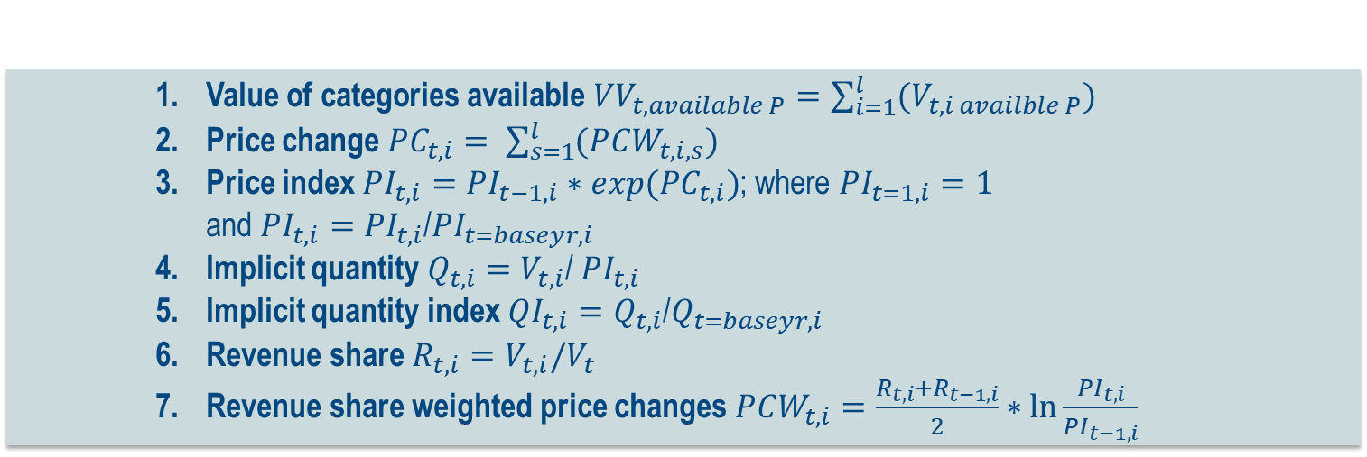
Output Measurement 3: Price
Clean data
Price $P_{t,i, s}=V_{t,i,s}/Q_{t,i, s}$
Total value of species $V_{t,i}=\sum_{s=1}^{l}{(V_{t,i,s})}$
Total value of species where $P$ is available ${VV}_{t,i}=\sum_{s=1}^{l}{(V_{t,i,s availble P})}$
Revenue-share $R_{t,i,s}=V_{t,i,s}/VV_{t,i}$
Revenue-share weighted price changes ${PCW}_{t,i,s}=\frac{R_{t,i,s}+R_{t−1,i,s}}{2}∗\ln{\frac{P_{t,i,s}}{P_{t−1,i,s}}}$
For each Species (s)
Value of categories available ${VV}_{t,available P}=\sum_{i=1}^{l}{(V_{t,i availble P})}$
Price change ${PC}_{t,i}= \sum_{s=1}^{l}{(PCW_{t,i,s})}$
Price index ${PI}_{t,i}=PI_{t−1,i}∗exp(PC_{t,i})$; where ${PI}_{t=1,i}=1$ and ${PI}_{t, i}={PI}_{t, i}$/${PI}_{t=baseyr, i}$
Implicit quantity $Q_{t, i}=V_{t, i}$/ ${PI}_{t, i}$
Implicit quantity index ${QI}_{t, i}=Q_{t, i}$/$Q_{t=baseyr, i}$
Revenue share $R_{t,i}=V_{t,i}/V_{t}$
Revenue share weighted price changes ${PCW}_{t,i}=\frac{R_{t,i}+R_{t−1,i}}{2}∗\ln{\frac{{PI}_{t,i}}{{PI}_{t−1,i}}}$
For each Fishery Category (i)
Price change ${PC}_{t}= \sum_{i=1}^{l}{(PCW_{t,i})}$
Price index ${PI}_{t}=PI_{t−1}∗exp(PC_{t})$; where ${PI}_{t=1}=1$ and ${PI}_{t,}={PI}_{t,}$/${PI}_{t=baseyr,}$
Implicit quantity $Q_{t,}=V_{t,}$/ ${PI}_{t,}$
Implicit quantity index ${QI}_{t}={QI}_{t,}$/${QI}_{t=baseyr}$
Quantity change ${QC}_{t}=ln⁡(\frac{QI_{t}}{QI_{t−1}})$
For the Entire Commercial Fishing Sector

